Slide 1

Value Driven Model for Healthcare
Where Value is Measured in the eyes of the patient

Slide 2
Outline
Challenges
Opportunities
Needs of the providers, practitioners, and patients
Measuring & Enabling Value
Engaging providers, practitioners, and patients
Towards a Collaborative Healthcare Model
Moving towards a new business model

Slide 3
Current Challenges
Escalating costs.
Fragmented funding models.
Reimbursement tied to results NOT value.
More difficult than ever to drive innovation & change.
Healthcare is fractionalized across the continuum of care.
The government is trying to lead healthcare reform.
Practitioners worry about quality, timeliness, and effort of care
Patients worry about quality of care, loss of control, and cost
Providers worry about loss of control and revenue

Slide 4
Opportunities
Hospitals can drive healthcare reform through the experiences they deliver (one patient at a time).
Opportunity for unifying the departments across the hospital to provide guidance and direction for change.
Opportunity to encourage collaboration and cooperation to solve the healthcare needs across the continuum of care (w/in & w/out the hospital).
Opportunity to create a holistic system of healthcare guided by consistent value-driven metrics (outcomes) to measure & ensure consistency, quality, and efficiency.

Slide 5
Needs of the Patients
To have affordable healthcare.
To have attainable healthcare.
To have more accessible healthcare.
To have consistent levels of quality (results).
To receive a total healthcare experience:
Ensure their functional outcomes met.
Ensure their emotional outcomes met.
Ensure their outcomes are met across the continuum of care (beyond the hospital, into clinics, and into the home).

Slide 6
Laboratories
Reducing Turn Around Times and Errors
Emergency Departments
Reducing diversions, improving flow
Outpatient Cancer Treatment
Reducing patient delays, increasing capacity
Operating Rooms
Reducing changeover times, increasing utilization
Pharmacies
Reducing errors, improving response
Food Service
Reducing wasted food, improving quality

Slide 7
Examples of Desired Outcomes
Category | Desired Outcome
Defects | Minimize the likelihood that the wrong label is placed on a patient’s fluid sample
Overproduction | Minimize the likelihood that blood is drawn from patients when they are sleeping (i.e. during 4am shifts)
Transportation | Minimize the amount of time required to retrieve inventory.
Transportation | Minimize the number of handoffs between staff for inventory
Transportation | Minimize the number of handoffs between staff for information

Slide 8
Examples of Desired Outcomes
Category | Desired Outcome
Efficiency | Minimize the amount of time required to fill a centrifuge
Inventory Mgmt | Minimize the amount of supply on hand for inventory (i.e. 50 weeks of supply)
Transportation | Minimize the distance a pharma Technician needs to walk to retrieve a printout
Inventory Mgmt | Minimize the likelihood that expired inventory is retrieved (i.e. Date/Time stamp is not used)
Human Potential | Minimize the likelihood that ideas are not considered when submitted by staff (i.e. Med Techs, RN’s ideas for improvement are often ignored)

Slide 9
Moving from Results-Driven to Value-Driven
Batch Thinking
Utilization
Keep expensive assets heavily utilized
Machines
Doctors
Queue Patients up
Convenience for staff
Patient Flow
Desired Outcomes
Minimize the amount of time that patients are left waiting in corridors
Minimize the likelihood that staff are rushing procedures (i.e. due to batch loading of orders)

Slide 10
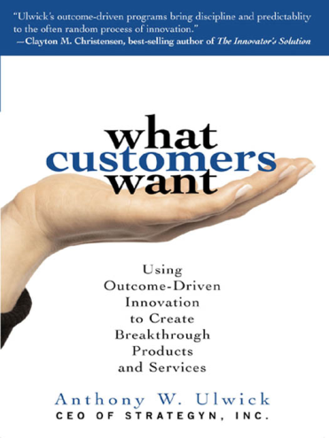

Drive LEAN with Value-Driven Measurement
Specify value in the eyes of the customer.
Identify the value stream and eliminate waste.
Make value flow at the pull of the customer.
Involve and Empower employees.
Continuously improve in the pursuit of perfection.

Slide 11
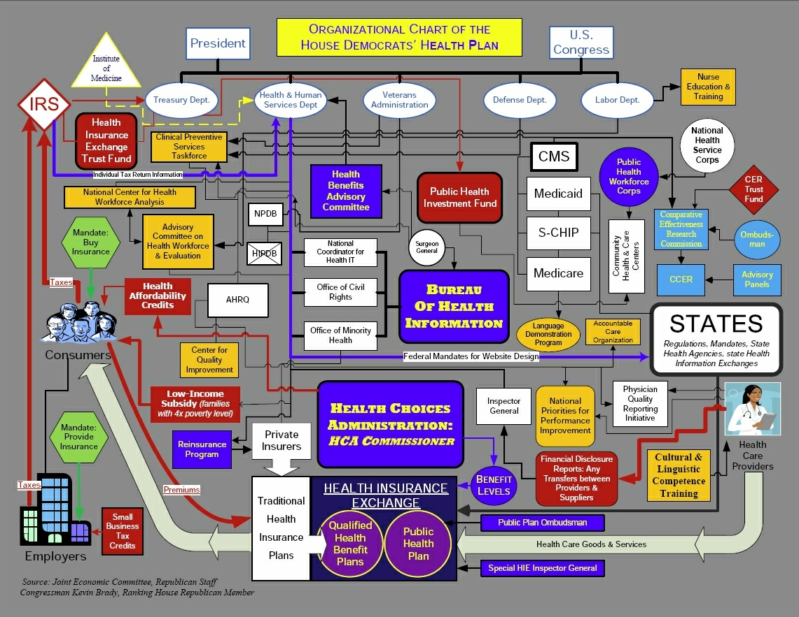

Slide 12
Needs of the Practitioners
To improve diagnostic capabilities in a cost-effective manner.
To improve clinical processes.
To provide consistent levels of quality.
To move beyond service, where they can deliver a positive experience.
To be able to reliably measure value for their patients, for themselves as individual practitioners , and for their practices.

Slide 13
Needs of the Providers
To get pharmaceutical and device manufacturers, insurers, and healthcare suppliers to become aligned, unified and collaboratively focused on a consistent set of outcomes.
To increase collaboration NOT competition.
To understand how to identify, measure and deliver value throughout the healthcare value network.
To move towards a shared revenue model where everyone can still win, but not at the expense of others (esp. the patients & the public).

Slide 14
Opportunity to enable Value
Innovate current business model to address the needs of the patients, practitioners, and the providers (3Ps).
Use a disciplined process to capture and assess the needs of the 3Ps in a quantifiable manner.
Provide a centralized repository of unbiased needs of the 3Ps to identify opportunities for measuring & creating value in the healthcare system.
Guide (and possibly drive) innovation in healthcare to create new value, while reducing the overall costs for the 3Ps.

Slide 15
Creating a Platform for Enabling Value
Defining & delivering the prescription for healthcare reform should come from within healthcare (not the government).
Creating a vision for a new healthcare system by forming a collaborative model with healthcare advocacy organizations, institutions, providers and practitioners.
Providing the practitioners with a consistent set of benchmarks for measuring the value they deliver to patients.
Driving open innovation among providers to create a more efficient process for guiding and creating value.
Working collaboratively with the government to guide more efficient and effective funding that drives healthcare reform.

Slide 16
Moving from Assumptions to Implementation
Establish a program focused on mapping the Jobs & Outcomes across the healthcare domain.
Build a portfolio of unmet needs (opportunities) for improving value delivery to patients and practitioners.
Establish a prioritization model to direct resources in an efficient manner.
Create an open innovation framework using the opportunities to generate ideas that can address the most important (prioritized) unmet needs.
Establish a shared revenue model as part of a collaborative to address unmet needs.

Slide 17
Value Measurement Platform for Healthcare
Healthcare Domains
Prevention
Diagnostics
Treatment
Maintenance
Federated Portfolio of Jobs & Outcomes
(Patients & Practitioners)
Jobs
Outcomes
Value is measured through Outcomes => Outcomes are used to enable value

Slide 18
Measuring Value for Healthcare
Build a portfolio of jobs & outcomes:
For measuring value
For capturing customer* needs
For guiding innovation
* The focus is on Patients and Practitioners in the Healthcare Value Network

Slide 19
Enabling Value for Healthcare
Healthcare Value Platform
Technology
Ideas
Resources
Priorities
Concept Development
Transitioning
To
Portfolio
Execution
Thru
Value Release
Outcomes
Compliance
Rules
Efficient value delivery for transforming healthcare and driving value

Slide 20
Enabling Value for Healthcare
Build an innovation portfolio to drive value by:
Creating a portfolio of outcomes that can be used by the 3 Ps to measure value.
Creating a portfolio of opportunities (IP)*.
Leveraging open innovation to create a portfolio of ideas to address unmet needs.
Engaging innovators in a collaborative effort to create new products and services to solve the most important needs in healthcare.
Aligning sustainable value delivery within a system of healthcare.

Slide 21
Engaging Providers & Innovators
Identifying priorities for healthcare upfront can:
Reduce the risks for investments in new products and services.
Focus 3rd party resources more efficiently.
Reduce the costs associated with investment planning.
Reduce the cycle time for new products & services addressing the most important needs in healthcare.

Slide 22
Engaging Providers & Innovators
Using a managed IP model will:
Encourage open innovation to leverage mindshare across all disciplines to solve the healthcare needs.
Promote collaboration instead of competition for new products & services to:
Bring new efficiencies to research and development.
Reduce the costs and cycle time.
Level the intellectual capital (IC) playing field for all providers and innovators.

Slide 23
Engaging Practitioners & Patients
Using a repository of outcomes will:
Provide practitioners with a consistent set of metrics for measuring value with precision:
Covering the realm of healthcare locations (hospitals, clinics, alternate site, and home)
Covering the breadth of healthcare practitioners (physicians, nurses, pharmacists, specialists, etc.)
Covering the flow of patients and the care they receive across the continuum of healthcare
Provides hospitals with a consistent benchmark for evaluating healthcare products and services

Slide 24
Engaging Practitioners & Patients
Using a repository of outcomes will:
Provide patients with a consistent benchmark for selecting products, services, and practitioners to meet their healthcare needs.
Provide consistent outcomes and quality of care from prevention to support (continuum of care) for all patients.

Slide 25
Towards a Collaborative Healthcare Model
The intellectual property (IP) repository will provide the healthcare organization with a unique value proposition to draw additional participants from across the healthcare value network (including patients) to enable value drive revenue potential.

Slide 26
Towards a Collaborative Healthcare Model
Access to the information in the intellectual property (IP) repository will:
Draw practitioners so they can more efficiently and effectively review and select products and services that can help them meet the patient outcomes.
Draw patients so they can review value-driven measures about providers, practitioners, products and services to make informed choices about their healthcare needs.

Slide 27
Towards a Collaborative Healthcare Model
Access to the information in the intellectual property (IP) repository will:
Draw providers so they can optimize their IC processes to deliver more efficient and effective value to practitioners and patients.
Draw investors from private and public sectors who are interested in leveraging information to optimize care for their employees.

Slide 28
Towards a Collaborative Healthcare Model
Patients
(Drugs, Devices, Information)
Practitioners
(Physicians, Nurses, Caretakers)
Providers
(Drugs, Devices, Information)
Providing Patients with a way to measure the value they should be receiving for healthcare throughout the continuum
Guiding Practitioners to measure and optimize the value they deliver to Patients
Guiding the Providers to deliver value to Patients & Practitioners
Healthcare Collaborative

Slide 29
Reducing Costs & Driving Value
Today…
Participants in the healthcare value network create value based on their own perceived understanding of customer needs.
Tomorrow…
A unified model of healthcare will be able to:
Understand customer needs throughout healthcare
Guide providers to build the right products & services
Deliver value to customers* throughout the healthcare continuum
* Practitioners & Patients

Slide 30

A New Business Model for Creating Value
Provides new value creation
Repositioned for leading healthcare change
Relevant to all Providers, Practitioners, and Patients
Provides thought leadership for guiding change and innovation
Open
Innovation
Centrally Managed
IP
Shared Revenue
Model
Results Driven
Prioritization
Collaborative
Orchestrates a unified value network for delivering efficient, affordable, and accessible healthcare to meet the unmet needs of customers
Ensures value can be measured, improved, and sustained

Slide 31
Towards a Value-Driven Model for Healthcare
Healthcare Collaborative Model
Healthcare
Advocacy
Groups
Healthcare
Disciplines
Providers
(Products & Services)
Institutions
Government Bodies
Advocacy Body for:
Value enablement
Value capture & measurement
Collaboration
Unification & cooperation
Reform & Sustainable Innovation
Enabling Value
Driving Innovation

Slide 32
Thank You
Prepared by
Jeffrey Wallk (Managing Partner)
Helene Sigman (Principle Consultant)

Slide 33
Management Consulting firm dedicated to helping clients identify & create sustainable value for their customers & stakeholders.

Slide 34
Our Services
Enabling Innovation
Institutionalize Customer Focus
Portfolio Mgmt for Customer Needs, Ideas, & opportunities
Drive efficiency into the ideation pipeline
Aligning Value Platforms with Technology Platforms
Enabling Adaptation & Agility
Model products & services for agility and adaptability
Drive reuse of assets thru holistic portfolio Mgmt
Leverage Quality to enable change
Optimize Platforms Change Mgmt Platform for sustainable value
Enabling Operational Excellence
Model-driven outcomes (beyond BPM)
Infuse Quality & continuous learning into all processes
Make technology transparent
Drive efficiency & productivity thru an outcome focus
Enabling Business Models
Profiling risk to create opportunity
Collaboration as a core competency
Leverage disruptive innovation
Fail Fast Forward to achieve growth
Embracing change
Modeling for sustainable value
Enabling Knowledge
Modeling data to enhance knowledge capture (explicit & tacit information)
Integrating information and insights to enable knowledge consumption
Designing platforms for sustainable learning

Slide 35
Our Expertise
Strategic
Operational
Technical
Change Management
Strategic Planning
Business Model Innovation
Enterprise Architecture
Concept Development
Driving Innovation
Continuous Improvement
Business Services
Process Models
Metric Models
Integration Platforms
Knowledge Management
Portfolio Management
Prioritization
Portfolio Planning
Resource Planning
Product Design - Testing
Execution Management
Product Marketing
Customer Focus
Market Assessment
Value Platforms
Investment Planning
Product Roadmaps
Portfolio Planning
Infrastructure Services
Technology Platforms
Technology Alignment
Technology Optimization
Service Level Management
Agile Delivery
Adaptable Design
Quality
Six Sigma
Lean & Kaizen

